Slide 1

The WI-FI Everywhere world
Andrew Baldridge 4/8/2015

Slide 2
WhAT is IT?

Slide 3
How things work now
Users want to be connected everywhere, and that won’t change
If you don’t want to use data but you’re out of a network range, tough luck

Slide 4
“What’s your Wi-Fi?”
“Can I get your Wi-Fi password?”
“I guess they don’t have any Wi-Fi here…”

Slide 5

Who’s at fault?

Slide 6
A Perfect world: Connect Everywhere
Cellular data connections are independent of themselves, Wi-Fi use is limited
Most Wi-Fi connections only exist in low service areas

Slide 7



Why can’t it be this easy?

Slide 8


Slide 9
Meeting in the middle
A Wi-Fi everywhere world

Slide 10
OZONE NETWORKS
ISP out of India
What Time Warner could only hope to be

Slide 11
India Continued…
Other companies already had some deals in place (sort of)
Air India
A 20 km free Wi-Fi zone
Telecom service provider Vodafone had introduced a Wi-Fi zone for its customers at the Belvedere Rapid Metro Station

Slide 12
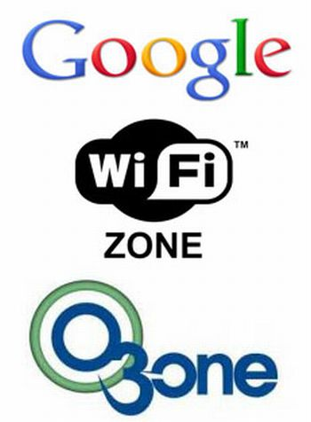
What did OZONE DO?

Slide 13

30,000 Units
WAP’s
Network Node
Network Tools

Slide 14
Can you imagine?
“Public Networks Division”

Slide 15
How do we get there?
ISP’s? Time Warner…LOL

Slide 16
Phone Companies? Nope

Slide 17


Search Engines!

Slide 18
RECAP
Things could be better
Time Warner is the DEVIL
A Wi-Fi everywhere world is very possible
It will more than likely be up to Search Engines rather than ISP’s (like Ozone) that would make it happen

Slide 19
Sources:
http://www.medianama.com/2014/11/223-ozone-networks-ericsson-public-wi-fi/
http://www.verizonwireless.com/wcms/consumer/shop/shop-data-plans.html
http://www.att.com/shop/wireless/data-plans.html
Google Images

